Slide 1
Project Details
Covid-19 Tracker App

Slide 2

What we talk today?
Kaung htet nyein . ….. (Use Case Diagram)
Htet Paing Oo(Er diagram)
Ko lin htet aung(Class Diagram)
Thu Thu San(Class Diagram)
Myint Zu Kyaw (Class Diagram)
Khin Nyein Wai(Flow Chart)
Question (whole group)

Slide 3
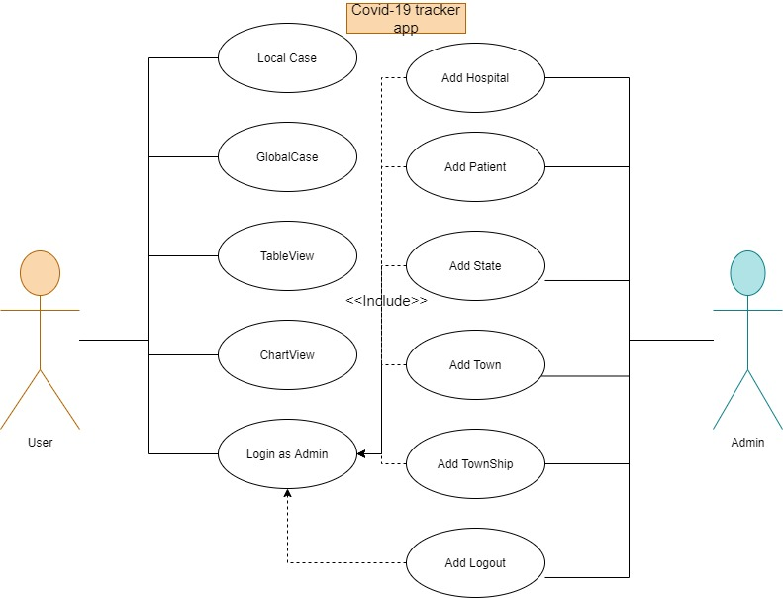
Use Case Diagram
I am User
I am Admin

Slide 4
ER Diagram
Not Fit in this slide :3

Slide 5
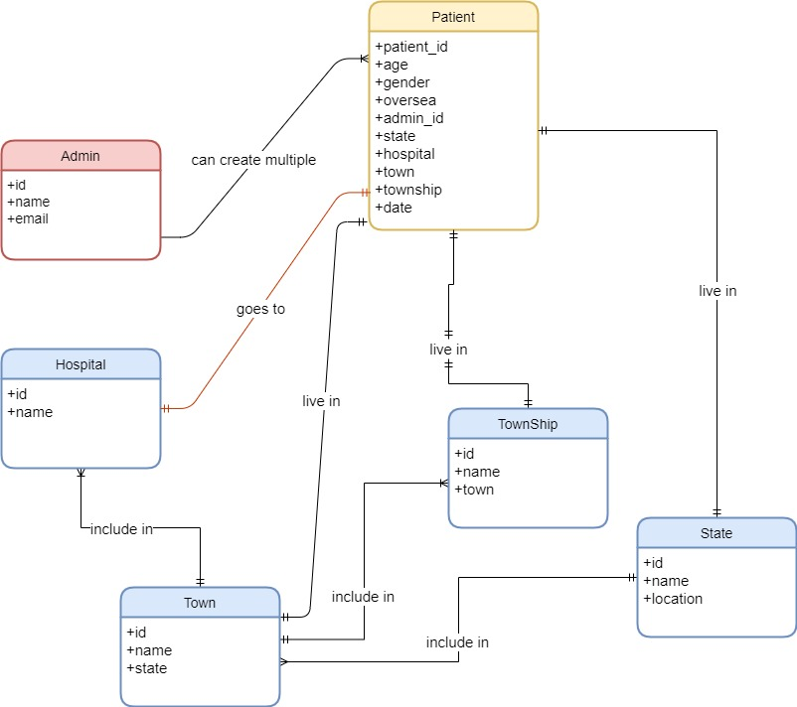

Slide 6
Class Diagram
Not Fit Again :3

Slide 7
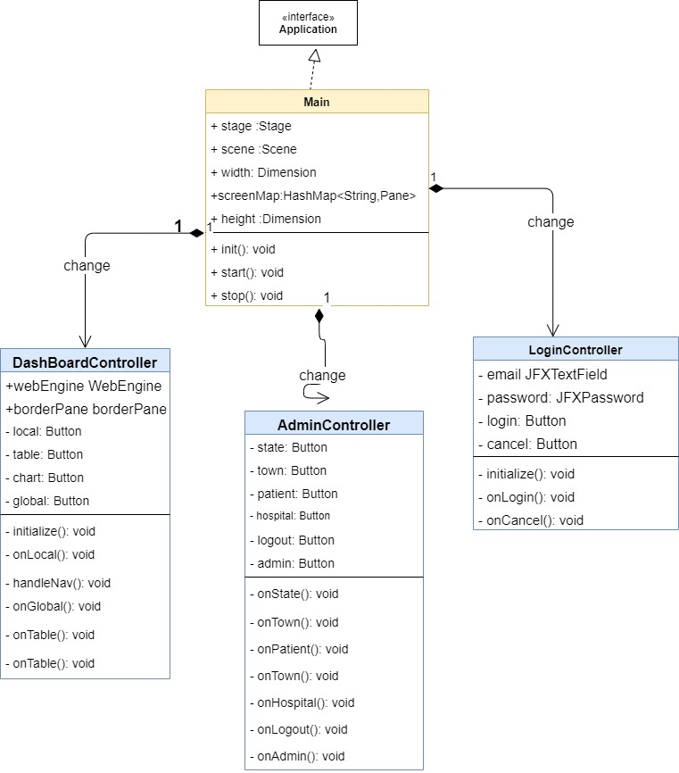

Slide 9
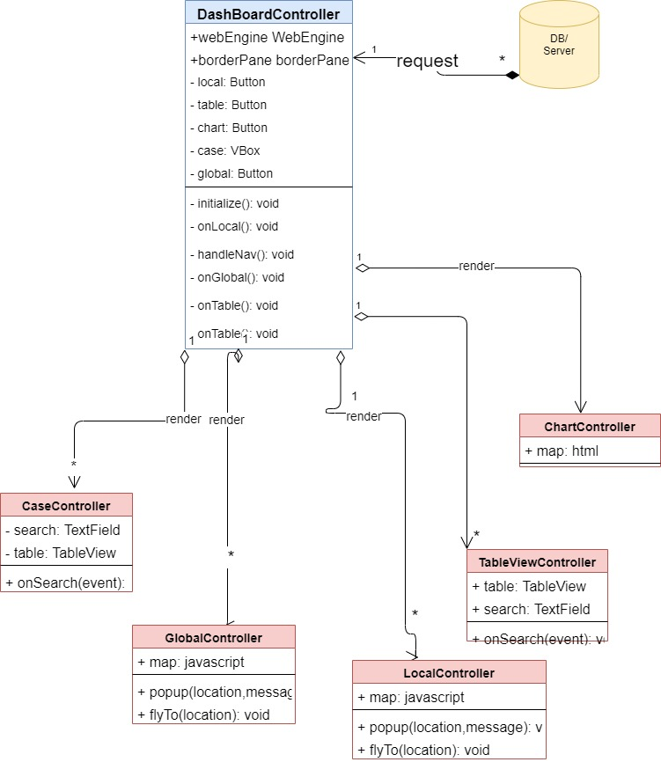

Slide 10
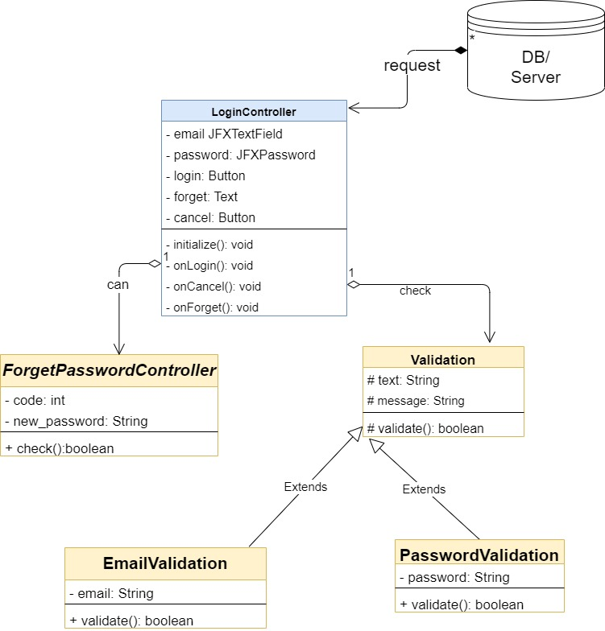

Slide 12
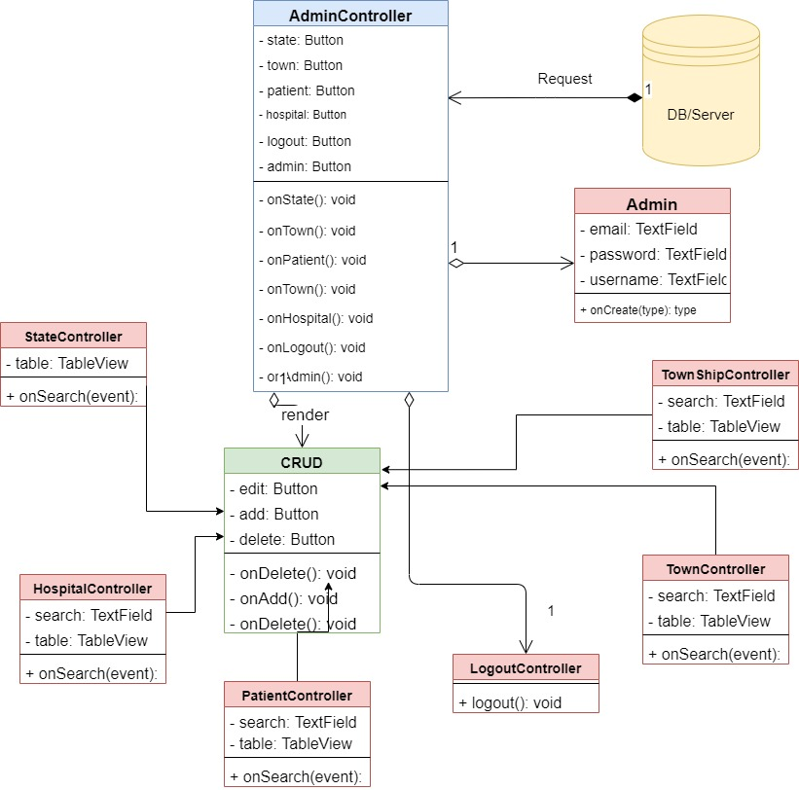

Slide 13
Actually Not Done :3

Slide 14
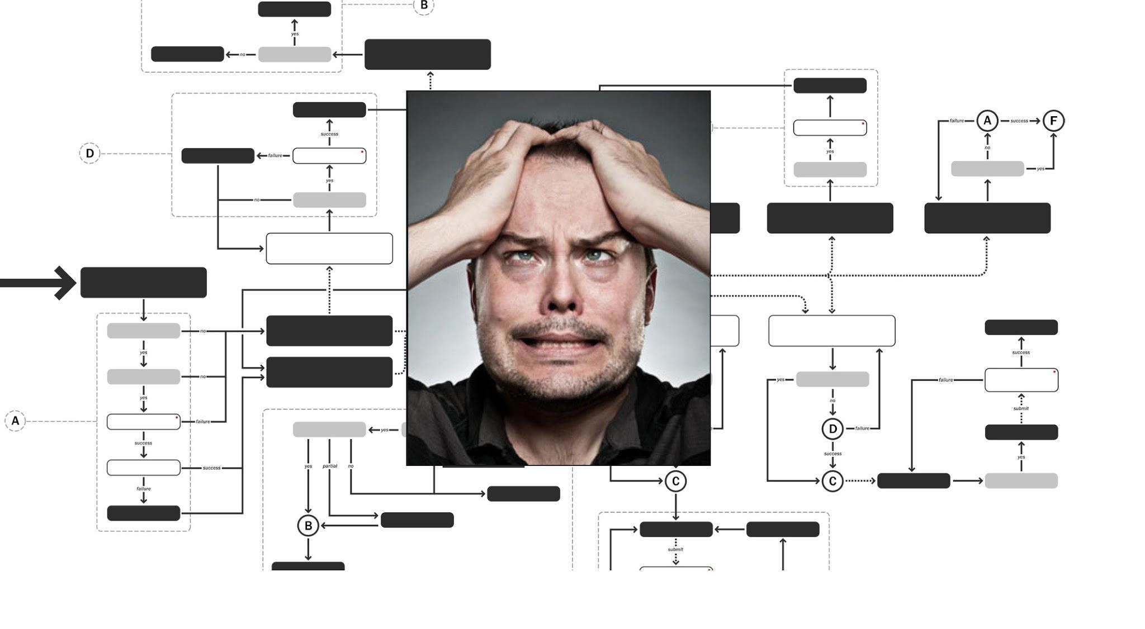
Flow Chart
Life is Pain ? Flow chart is freaking pain ヽ(ಠ_ಠ)ノ

